Slide 1
SENTIMENT ANALYSIS OF OPAY APPLICATION REVIEWS
Presented By:
Gbadamosi Oluwaseyi Emmanuel (16/52hl028)
Supervised By: Mr. Nasir Aliyu.

Slide 2
Agenda
01
Introduction
02
Statement of Problem
03
Aims and Objectives
04
Importance of Research
05
Related works
06
Methodology
07
Finds and Discussions
08
Recommendation

Slide 3

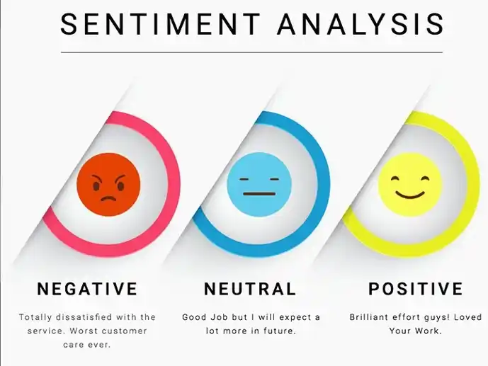
INTRODUCTION
Sentiment analysis is an approach to natural language processing (NLP) that identifies the emotional tone behind a body of the text.
This is a popular way for organizations to determine and categorize opinions about a product, service, or idea.

Slide 4
STATEMENT OF PROBLEM
OPay emergency has brought Nigeria's fintech market a new definition of being a one-stop mobile platform for payment, transportation, food & grocery delivery, and other important services in daily life. Millions of users rely on OPay to send and receive money every day, pay bills, and order food and grocery. Opay is still ranked one of the most promising payment platforms, compared to similar services from its competitors.
Opay must be able to continuously improve the service in various aspects to maintain the best service to consumers. One is the opay app in Google Play Store. Therefore, a more flexible and robust approach is needed to measure the extent of the results of sentiment that customers give to the opay application through the Play Store comment column. Positive, negative, or neutral comments are taken to obtain customer opinion

Slide 5
AIMS
This project aims to analyze the sentiments about opay applications in the Google Play Store and to determine the level of user satisfaction based on comments in the Google Play Store review column and to determine the level of service success, shortcomings, and how to further improve the app for better customer experience based on community sentiments.

Slide 6
OBJECTIVES
Classifying the extracted data using Random forest as a supervised data mining algorithm to predict good and bad reviews.
To analyze the reviews of users on the opay application to extract sentiment
To get valuable insight on the level of app success, shortcomings, and how to further improve the application for a better customer experience.

Slide 7
IMPORTANCE OF RESEARCH
It gives an in-depth examination of the Opay application's reviews.
To evaluate user responses for positive and negative feedback.
A score assigned to each comment will aid in determining what the user thinks of the app.
The information obtained from the review will assist developers in creating a better application.
User comments are normally helpful in stopping other users from downloading the spam application.

Slide 8
RELATED WORKS
Al-ayyoub et, al.
Ranjan and Mishra.
Xing and Justin
proposed a supervised machine learning enhanced approach to extract aspects and classify sentiments for hotels’ Arabic reviews in the SemEval-2016 dataset
worked on the correlation between the university student’s reviews and the Google app reviews via an exploratory analysis and visualization of sentiment polarity, subjectivity versus other features like price, installs, type, size, category, and ratings
This paper tackles a fundamental problem of sentiment analysis, sentiment polarity categorization.
2015
2018
2020
2017
2019
Manek, Shenoy, and Mohan,
Alqaryouti and Siyam
proposed a feature selection method based on Gini index. To predict sentiment polarities for a movie review dataset, the authors used the SVM classifier
propose an aspect-based sentiment analysis hybrid approach that integrates domain lexicons and rules to analyze the entities' smart apps reviews.

Slide 9

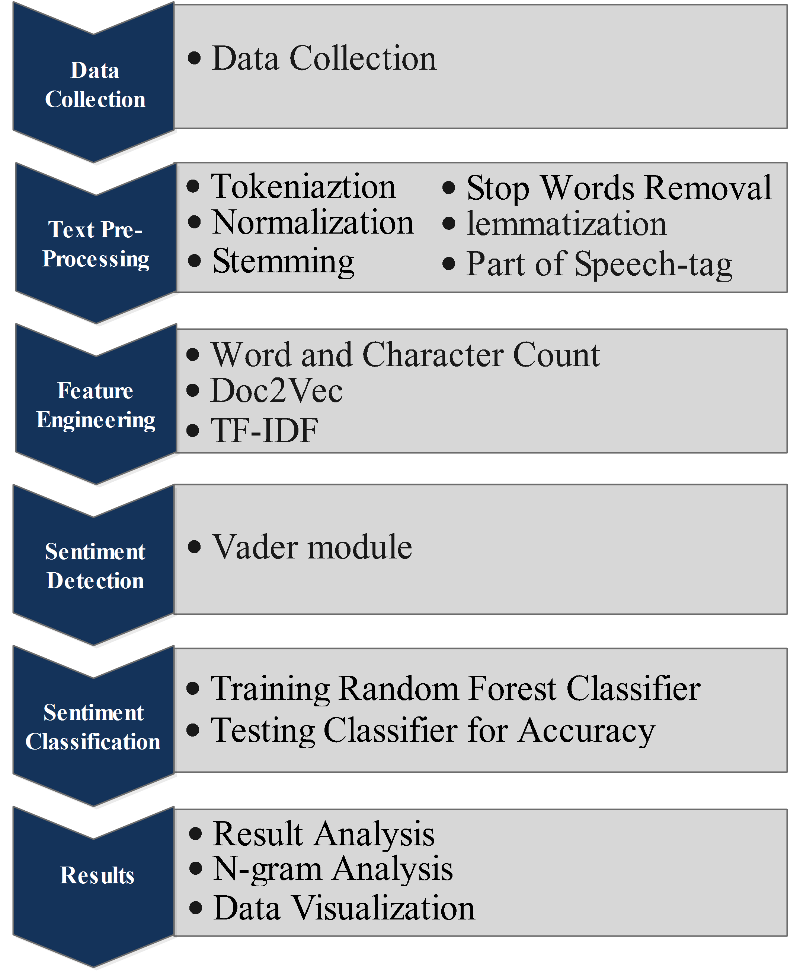
METHODOLOGY

Slide 10
FINDINS AND DISCUSSION
Objective 1 Classifying the extracted data using Random forest as a supervised data mining algorithm to predict good and bad reviews –
The random forest model predicted 564 reviews as good incorrectly and 445 reviews as bad incorrectly, the classifier predicted “Positive” 5220 times, and "Negative" 2053 times. In reality, the classifier predicted “Positive” 5287 times, and "Negative" 1956 times.
The trained random forest classification model had an accuracy of 86%, the precision of 87%, recall of 86%, and an average cross-validated Receiver Operating Characteristics (ROC) Curve of 90% indicating a relatively good model.
The Precision-Recall Curve shows the calculated precision and recall at various threshold values. The precision values for our model remain relatively stable at each threshold AP= 0.95.

Slide 11
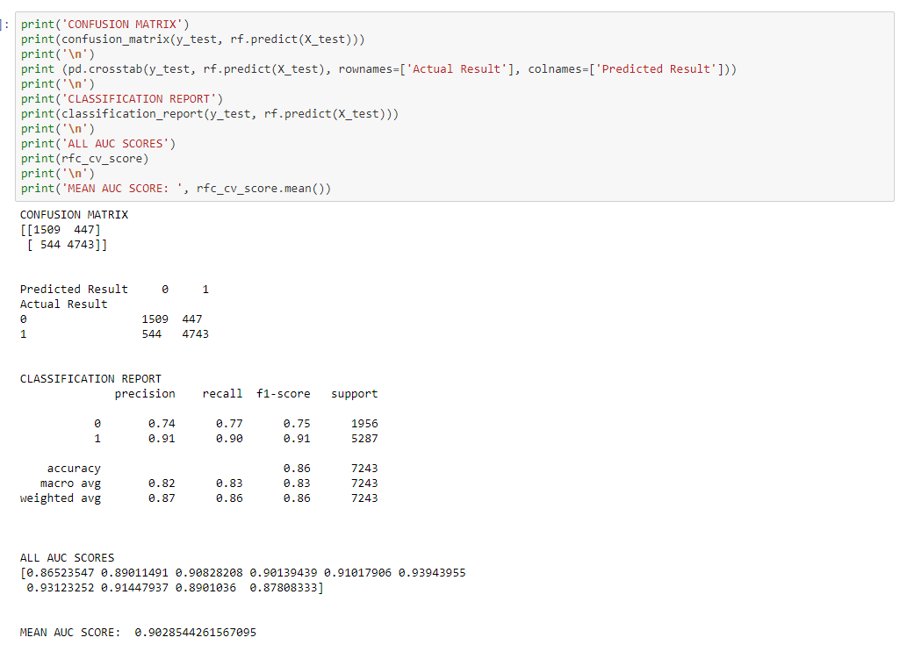
FINDINS AND DISCUSSION

Slide 12
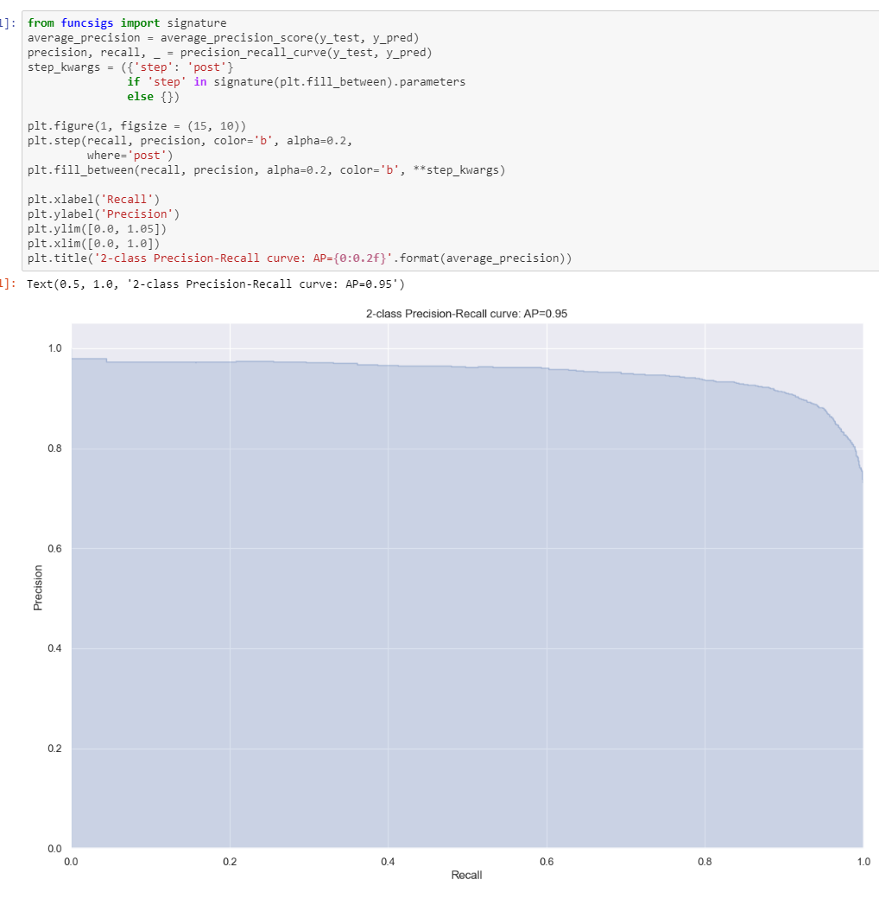
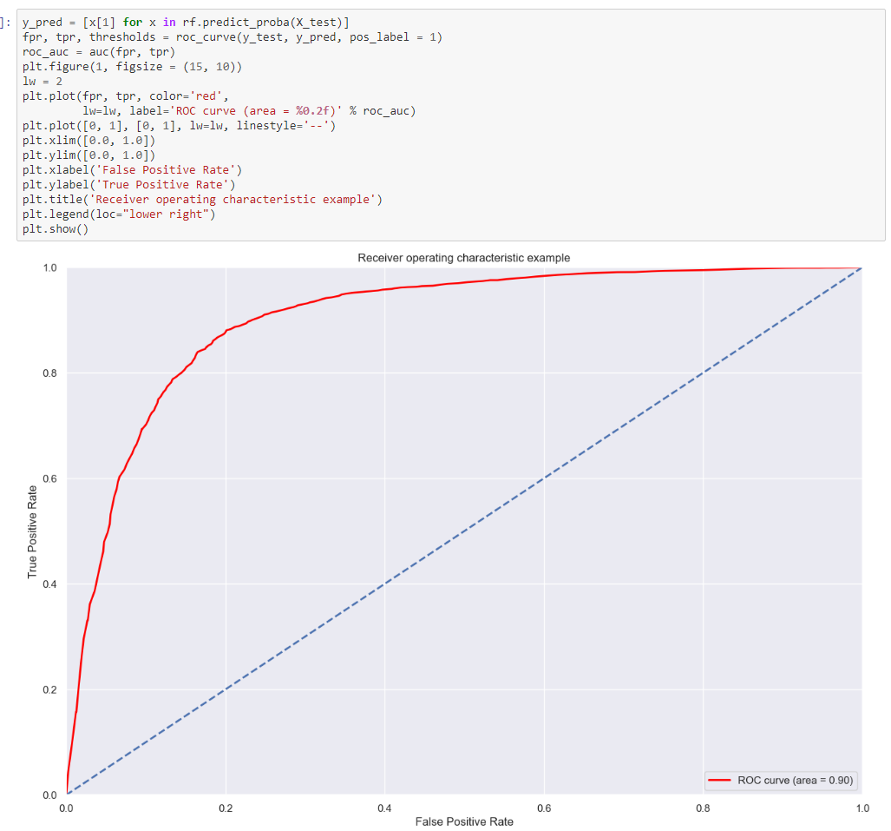
FINDINS AND DISCUSSION
PR Curve
ROC Curve

Slide 13
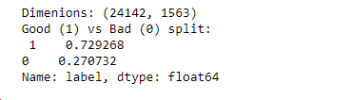
FINDINS AND DISCUSSION
Objective 2 To analyze the reviews of users on the opay application to extract sentiment –
After extracting sentiment from the reviews using the Vader module, positive reviews had the highest number of 73% while negative reviews had the lowest number of 27%. According to the number of reviews positive reviews had the highest number of reviews which means people are satisfied with the app.

Slide 14
FINDINS AND DISCUSSION
Objective 3 To get valuable insight on the level of app success, shortcomings, and how to further improve the application for a better customer experience –
App success: The result shows that users are happy and like the app because it is fast, efficient, and easy to use. Some key functions that users enjoyed were Oride service, electricity bill payment, airtime fill up, TV subscriptions amidst other services.
Shortcoming: Many users complained of experiencing technical issues of the app not able to connect to the internet on their mobile phones, also geo-location for oride service not accurate causing late arrival of riders, riders misbehave, agents Unable get a commission on some services and charges on a transaction is high.
Improvements: Reviews suggest the use of debit cards, POS to receive money from other banks, adding daily subscriptions to the data package, decrease the airtime limit, and set geo-location to have high accuracy, need to scale backend server and make the response time of the server more efficient.

Slide 15
RECOMMENDATIONS
There are some suggestions and recommendations that should be done to improve the analysis done which could be:
Examine word vector visualizations to see what insights can be learned (word2vec).
Include n-grams in the training set for models and evaluate if accuracy is improved.
Train model to determine sentiment specific to review text (perhaps SVM model with sparse matrix). Determine if accuracy improves in model and predictions.
Create a custom stop word list to improve model accuracy.

Slide 16
THANK YOU!

